Slide 1
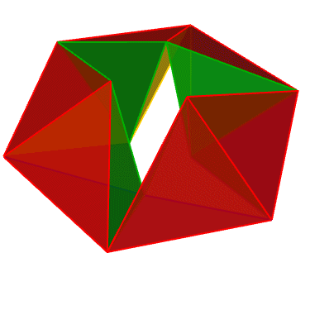
KINETIC ART:
Kaleidocycles
EDSE 435
Dr. Olga Rubio
Oscar Duarte, Diana Lopez Gallegos,
Gicela Salgado, Ryan Tacata, Priscilla Vega

Slide 2
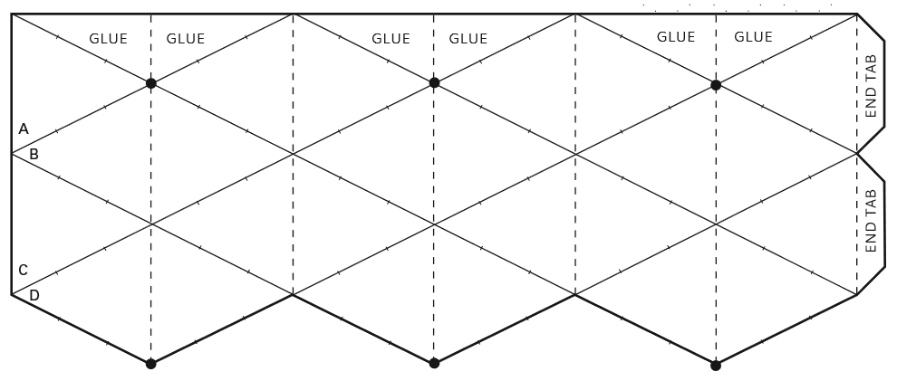
Narrative Overview
Kinetic art, such as “Kaleidocycles” or “Flextangles”, are fun and entertaining ways to introduce students to concepts from different content areas. For art classes, they can used to teach form, shape, color, line and value. In math, they can touch upon topics like angles, planes, shape and geometric concepts. In science, they can be used to visualize cycles, such as life cycles, seasons, photosynthesis, etc. And in the humanities, they can be used to illustrate poems, discuss storylines and document historical events.
Kaleidocycle Video
Ryan

Slide 3
Student Learning Outcomes
Student will learn to analyze and respond to sensory information that will help as a scaffolding for their critical thinking to identify and discuss the elements of art and demonstrate cultural appropriate practices perspectives to others.
Student will learn to communicate meaning and intent in an original work of art for
drawing literary to support analysis, reflection or research.
Students will learn to solve problems applying core concepts from geometry.
Diana

Slide 4
Connection to CRP Principles
Empowering
During the math portion of the lesson, students will be required to persevere through tedious work (calculating perimeter and area) in order to come to a larger understanding of geometry and mathematics.
Validating
This lesson is validating in part because it requires students to tap into their prior knowledge of geometry concepts that they had learned in middle school. The lesson will delve deeper into the concepts of geometry, so the teacher will be looking for ways for students to make those connections with minimal help from the teacher.
Multidimensional
This lesson is multidimensional in that it weaves art, mathematics, and the humanities to provide a framework of interconnectedness between different content areas, and how all these subjects can converge onto one distinct focal point (kinetic art, in this case).
Transformative
Many of our students will be students of color, most likely Latinx students. This CRP lesson will teach students to be proud of their ethnic identities and cultural backgrounds. We want to connect the lesson to Latin-American artists who have used kinetic art heavily in their oeuvre.

Slide 5
Common Core Standards: ART
1.0 ARTISTIC PERCEPTION - Processing, Analyzing, and Responding to Sensory Information. Through the Language and Skills Unique to the Visual Arts. Students perceive and respond to works of art, objects in nature, events, and the environment. They also use the vocabulary of the visual arts to express their observations.
2.0 CREATIVE EXPRESSION - Creating, Performing, and Participating in the Visual Arts. Students apply artistic processes and skills, using a variety of media to communicate meaning and intent in original works of art.
2.1 Solve a visual arts problem that involves the effective use of the elements of art and the principles of design.
Diana

Slide 6
Common Core Standards: ENGLISH
CCSS.ELA-LITERACY.CCRA.W.4
Produce clear and coherent writing in which the development, organization, and style are appropriate to task, purpose, and audience.
CCSS.ELA-LITERACY.W.9-10.3.D
Use precise words and phrases, telling details, and sensory language to convey a vivid picture of the experiences, events, setting, and/or characters.

Slide 7
Common Core Standards: MATH
HSG.MG.A.1
Use geometric shapes, their measures, and their properties to describe objects (e.g., modeling a tree trunk or a human torso as a cylinder).
HSG.MG.A.3
Apply geometric methods to solve design problems (e.g., designing an object or structure to satisfy physical constraints or minimize cost; working with typographic grid systems based on ratios).
Ryan

Slide 8
Common Core Standards: Spanish
WL.CL1.A
Interact with cultural competence in most informal and formal settings.
WL.CL3.A
Describe and explain similarities and differences among products, practices and perspectives of general public interest in the mainstream cultures of the United States, the students’ own cultures, and the target cultures.
Gicela

Slide 9
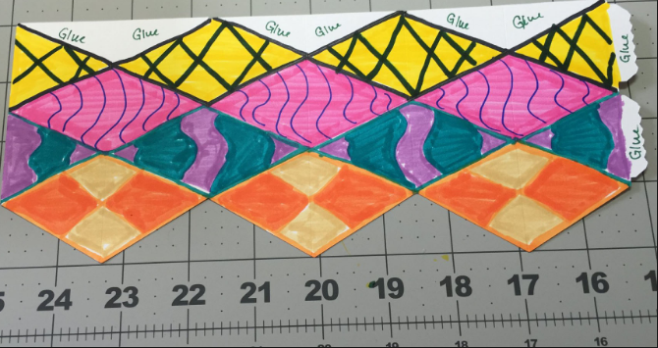
Required Materials Priscilla
For the art project: Paper, x-acto knife, cutting board, paint, ruler, scissors, markers, pencils, ink, glue.
We would also use handouts with instructions (in different languages, if possible), visual instructions (step-by-step images), technology (i.e. tablets, internet, PowerPoint presentations).

Slide 10
Assessment of Student Learning Outcomes Priscilla
The teacher will model the gallery walk activity to students before letting them do it on their own. Each student will receive a “two stars one wish worksheet” to talk about the art they are looking at. For students who have difficulty moving around, the teacher can place 3-4 artworks at their table for them to choose one. Once they have chosen one, they will use it to fill in their “two starts, one wish” worksheet. For ELL students, they will be able to fill in their worksheets in their own language.

Slide 11
Essential Questions
How does knowing the contexts, histories, and traditions of art forms help us create works of art and design?
How has kinetic art influenced our society?
Is it important to be able to think outside the box and be creative for the future?
What can we learn from someone’s past?
Why and how does art define a culture?
How can we better understand concepts like angle, point and intersection through physical models?
GICELA

Slide 12
Differentiation: ELL (Level 3)
We can have bilingual instructions for the project
A step-by-step instruction sheet with pictures of every step will also help students not rely on text they may or may not understand
ELL students can also be grouped/paired with students who are fully bilingual so that they are not only able to speak in their native language, but there is also room for learning English with their bilingual classmate
Work not finished in class may be taken home to be completed as homework
Allow some scaffolding with the native language
Gicela

Slide 13
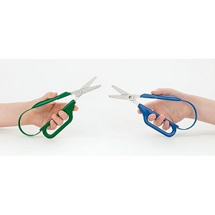
Differentiation: Cerebral Palsy
Something to add to the list of materials is possibly Easi-grip scissors
Something else to add to the list of materials is wood pattern blocks
Have the students work with a cutting buddy or a folding buddy
Instead of having them cut out and glue on a design they can use a design already created or create their own to color in
If students are able to they can use technology to color in the template and have them print it out in color (think like coloring app on your phone except on a bigger canvas)
A material may possibly be iPads then, so that the students is able to have that as an option
Ryan

Slide 14
Differentiation: Autism Spectrum
A student on the spectrum may not have the patience to sit and cut out a design, so they could also use the templates instead
In certain cases, student may be too shy to read their report out loud to the class, so they may possibly have a buddy who can read the speech for them or they can just turn in the report to the teacher
The student can be encouraged to work with groups during the “gallery walk” in math class by being offered a preferred reward after having completed the task (i.e. free time on the tablet, drawing time, they can listen to music on their phone/iPod, etc.)
Oscar

Slide 15
Differentiation: ADHD
Since they may have difficulty sitting still, they will have the option of standing while working.
We can have standing desks in a designated area of the classroom.
This area can also have extra posters that go through all processes/rules/routines.
The gallery walk assessment can help kinesthetic learners and students with ADHD be active by moving around the classroom.
We can also provide students with a video step-by-step instruction that they can view on a tablet/Chromebook/etc...
Oscar

Slide 16
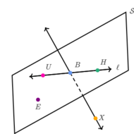
Step-By-Step Procedures: Math
Day 1:
Opener & Discussion
Concepts of geometry
Lesson
Activity
Shapes from 4 isosceles triangles/posters
Closure/Exit ticket
Day 2:
Opener
“Gallery Walk”
Take notes on others’ categories
Lesson
Calculate the perimeter and area of their shapes
Day 3:
Opener
Intro. to Flextangles/Kaleidocycles
Activity: color, cut and assemble their models
Lesson
Connection to geometry unit which will follow
Defining angle, circle, perpendicular line, parallel line and line segments
Ryan

Slide 17
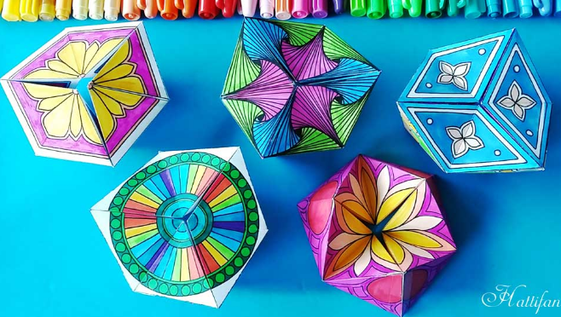
Step-By-Step Procedures: Art
Day 3 cont.:
Closure:
Clean/ Return Materials.
Research for artsy ideas for Flextangles
Bring 4 ideas for next class look Zentangle
Day 4
Opener/Warm-Up
Introduction to artist
Brief introduction of the artist Jesus Rafael Soto
Activity Decoration fo flextangles/Zentangle
Closure
Clean up/ and finish projects at home.
Oscar

Slide 18
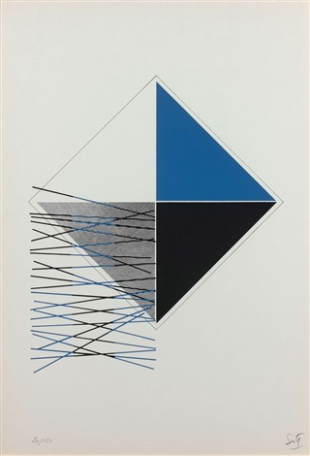
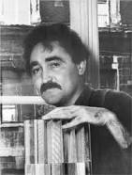
Jesus Rafael Soto Brief Introduction
Jesus Rafael Soto was a Venezuelan artist. Soto’s works
contained geometric and organic forms. In the 1960s.
he created the installations for which he is best known today:
linear structures made from industrial materials like nylon,
Perspex, and steel intended for the participant to walk through.
Jesús Rafael Soto (Venezuelan, 1923–2005)
Title: Composition. Medium: color lithograph.
Size: 49 x 34 cm. (19.3 x 13.4 in.)
Diana

Slide 19
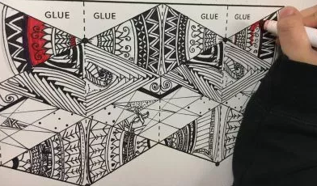
Zentangle
For this Project, we will create a Flex angle that are perfect kinetic and movable mathematical sculptures for all. This project will help the students to addresses some of the Elements of Art like shape, form, value, color, and line. It will also introduce them to the Zentangle Method which is an easy-to-learn, relaxing, and fun way to create beautiful images by drawing structured patterns.
Diana

Slide 20
Step-By-Step Procedures: English
Day 5
Opener/Warm-up:
Discussion
Mini lesson: Show one of Jesus Rafael Soto’s works and what inspired him.
Fork activity
Discussion
Application
Write a paragraph
Closing:
Day 6 (Extra)
Opener/Warm-Up
Gallery walk
Two Stars one Wish
Priscilla

