Slide 1
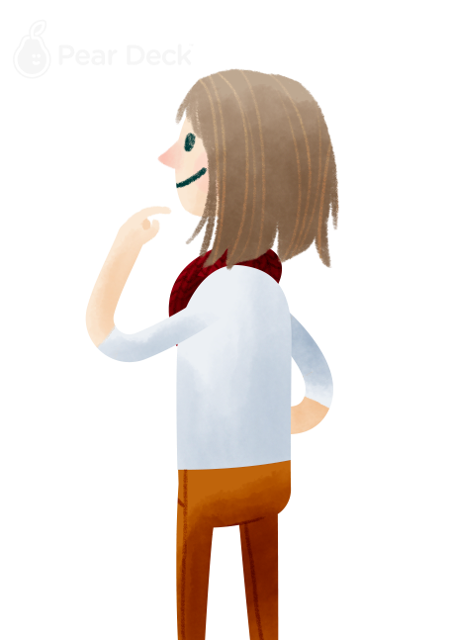
Pear Deck is a Google Drive free presentation app created by educators to maximize exposure to technology as educational tool to increase student/teacher interaction with one another.
Notes:
Comments:

Slide 2
Once a slide presentation is ready, the teacher is able to publish it and make it accessible to all class.
During presentation, students follow slides in their own screen and input their comments and responses live.
Their participation can be public or private from all class, but accessible to teacher at all times.
Notes:
Comments:

Slide 3
Let's give it a test drive.
Drag your dot to show if you’re ready to move on:
Notes:
Comments:

Slide 4
Assuming that you the teacher introduced the lesson. She/he can ask students questions such as: What do you want to know about today’s topic?
Their responses will appear in the bellow box
Notes:
Comments:

Slide 5
The teacher can also engage students in visual exercises such as:
Draw or type 2 things you already know about today’s topic
Notes:
Comments:

Slide 6
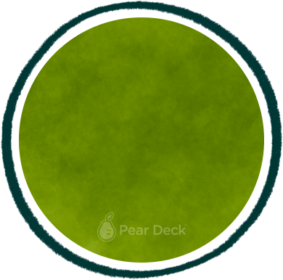
Participation can also be as simple as:
Is this statement true or false?
True
False
Notes:
Comments:

Slide 7
Or…
Drag your dot to how you are feeling:
Keep going, I understand
I’m a little confused
Stop, I need help!
Notes:
Comments:

Slide 8
And…
Draw lines to match the image to the answer:
Red
morado
Green
azul
Orange
naranja
Blue
verde
Yellow
rojo
Purple
amarillo
Notes:
Comments:

Slide 9
Reflection can also be completed thought Pear Deck with assignments such as:
In a couple minutes, write the most important thing from today’s lesson.
Notes:
Comments:

Slide 10
Teachers can even encourages note taking with exercises such as:
Pretend your friend was absent from class today…
Write what you would say if you had to explain the lesson to your friend.
Notes:
Comments:

Slide 11
The exercise can also serve for teachers to evaluate how effective was the lesson and how to potentially improve it by asking students questions such as:
Circle how you are feeling about the lesson and in one sentence, explain why.
Notes:
Comments:

